Slide 1
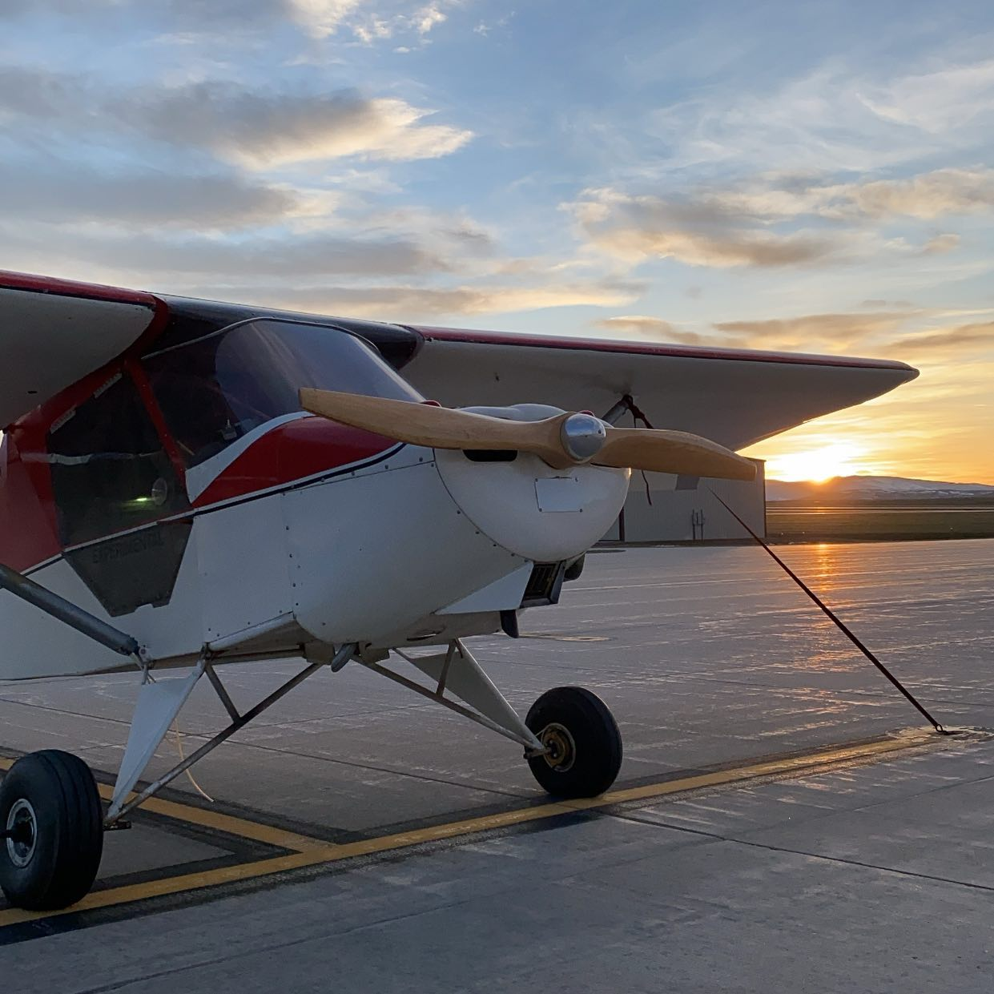
End Of Quarter
From Scatter to Structure: Automating the Path to Address Accuracy
Author: Sherya,Wenjun,Ruijie,Amit,Peilu
Instructor:
Josue & Carrie

Slide 2





Team Members and Responsibilities
Ruijie Shan
Collaborates with Wenjun on technical progress, supplement tasks on web-scraping, automated pipeline .
Wenjun Song
Leads technical aspects (Custom Search, Web-scraping, Proximity Based Filtering)
Amit Gangane
Manages deadlines, team coordination, technical lead in tasks like custom search API.
Peilu Han
Visualizing web-scraping research results, quantify current research outputs.
Shreya Chandra
(Project Manager) Manages the project ,communication with MIP & instructor.
1

Slide 3
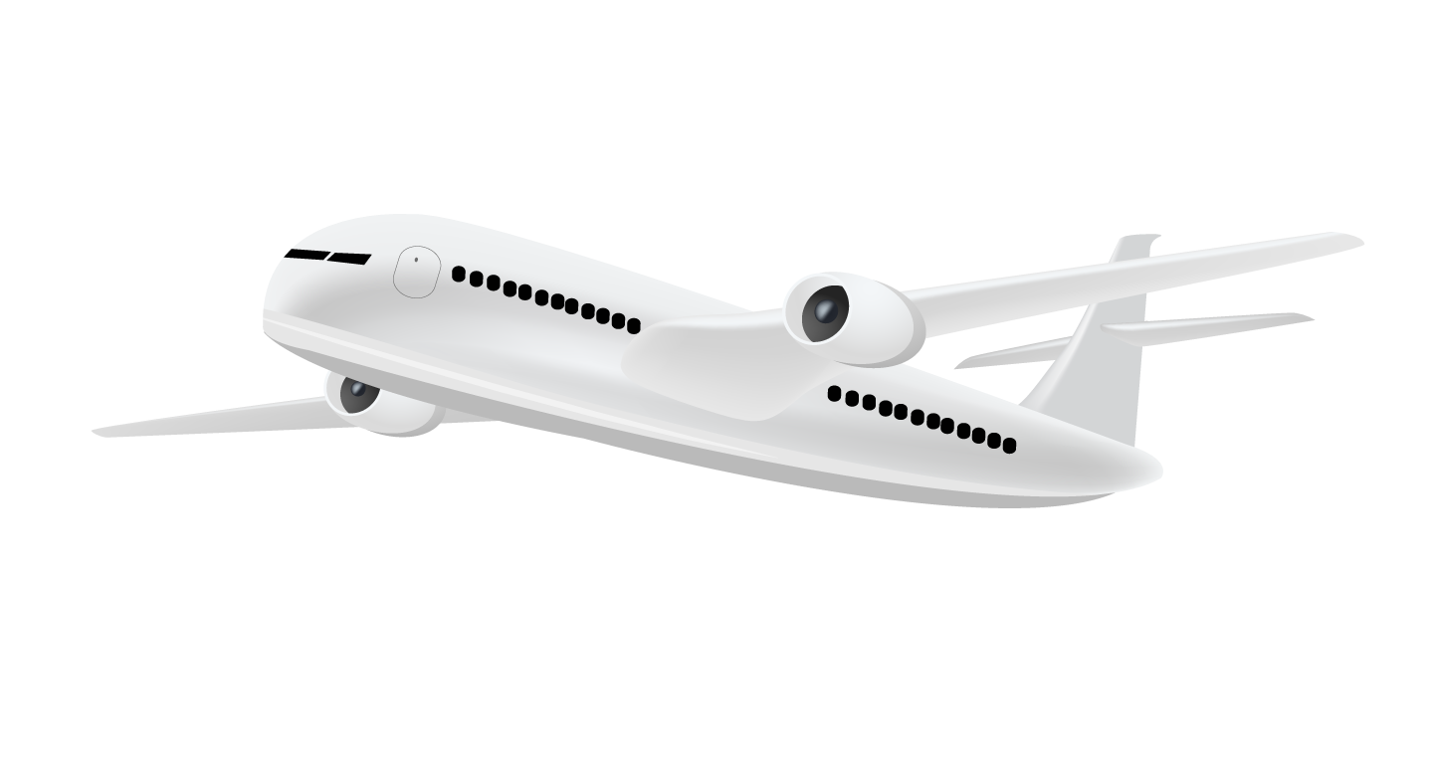
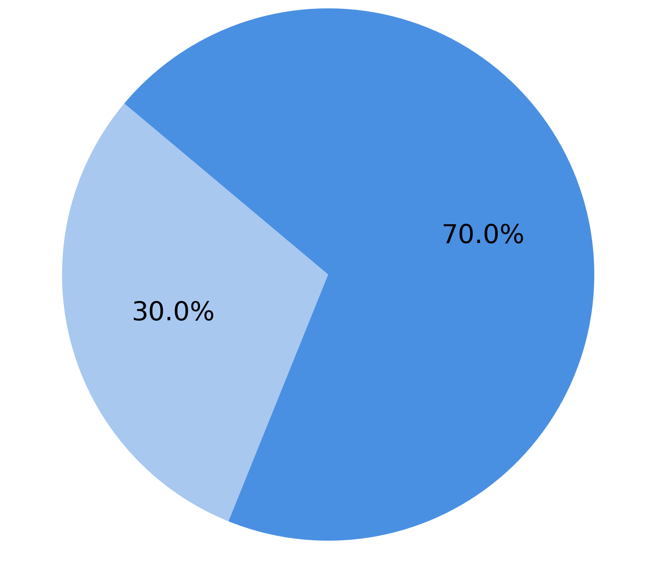
Thousands of agencies exist, but nearly a third of them have no known address
Incomplete Address Data
Over 7,000 agencies
30% of them lack address info (within last 6 years)
Address Completeness of 7,000+ Healthcare Agencies (Last 6 Years)
*Agency: healthcare-related organization
Consequence
Have Address Info
Increased administrative workload
Limited service expansion
Missing Address Info
Notes:
Adding the def of agency

Slide 4
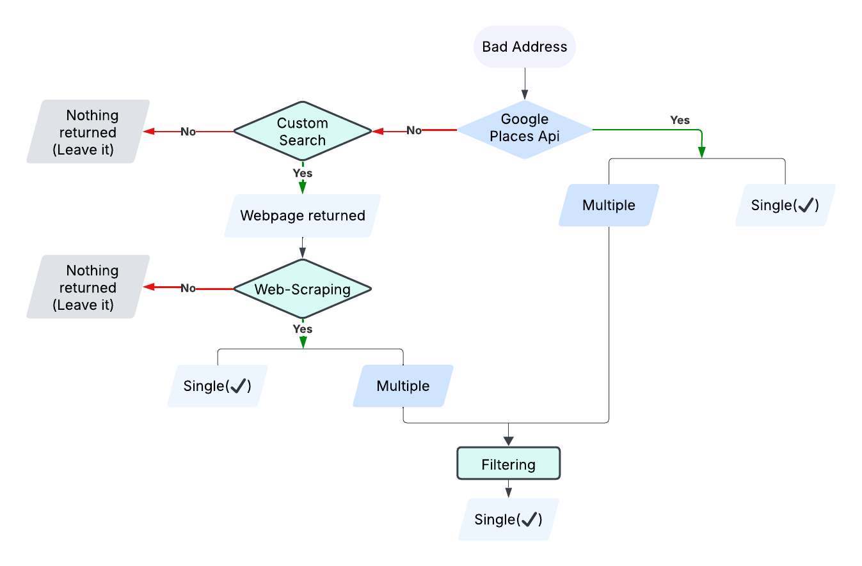

Without complete address data, service expansion stalls and workload surges
Our Current Work:
Developed By Last Year Practicum

Slide 5
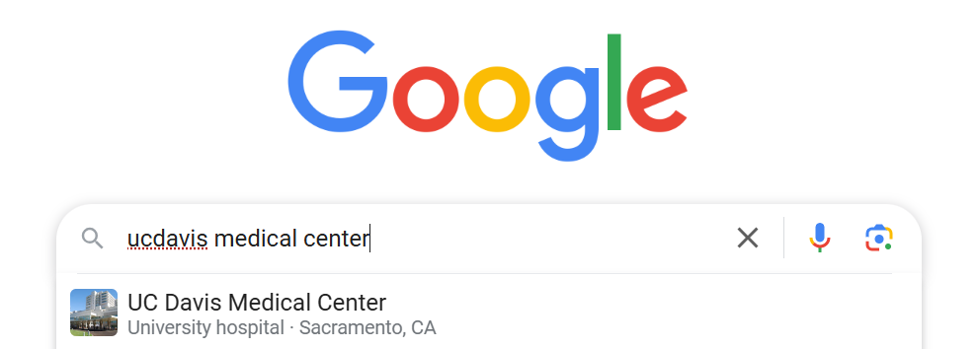
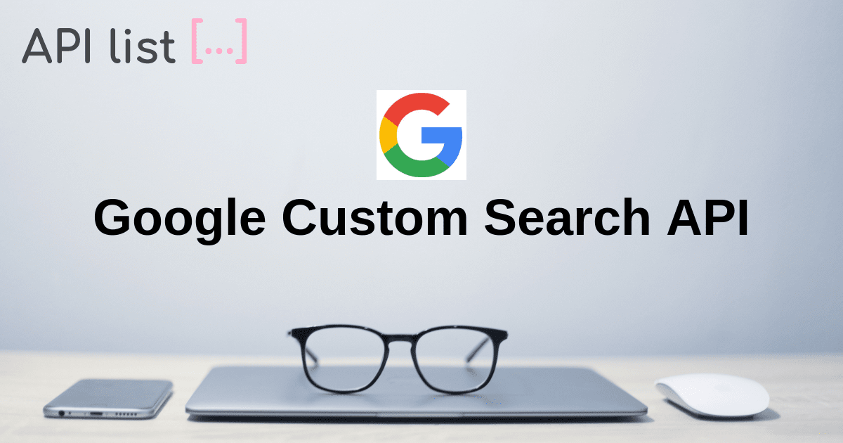
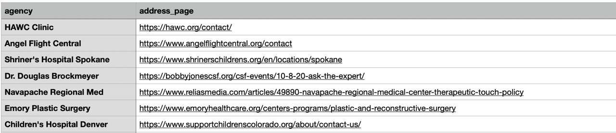
30% of Agencies Lack Address Info — We Turned to Website Search to Close the Gap
https://health.ucdavis.edu/medical-center/
4
Notes:
Go slow(ucd ->list of agencies) So, we decided to use the Custom Search API to make it easier and more accurate to find the correct webpage URLs with address information from official websites. This will help us fix the issue where our previous method struggled to pick the right address when multiple options were available.
4

Slide 6
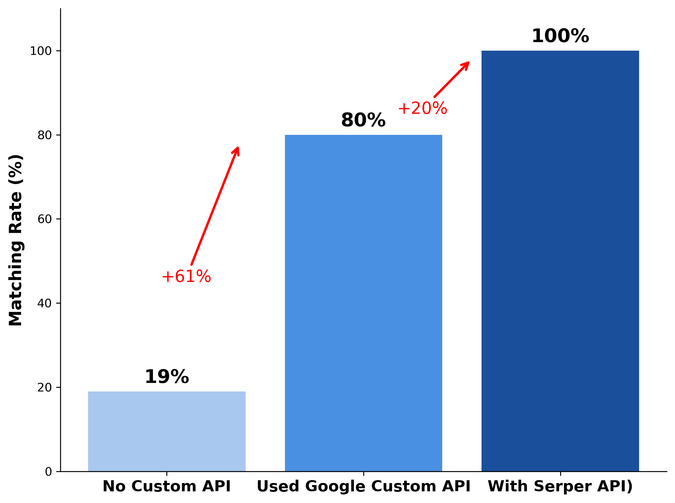
We began with search—finding agency websites through improved queries
Website Extraction Success Rate
Improved Query Structure: adding “official site”, “contact”, and “address” keywords
Prioritize official domains: .gov, .org, .edu
Integrate Serper API
Notes:
Before Applying custom search…previous:19 -> 80%
“Last Quarter”is confusing So, we decided to use the Custom Search API to make it easier and more accurate to find the correct webpage URLs with address information from official websites. This will help us fix the issue where our previous method struggled to pick the right address when multiple options were available.
5

Slide 7
Further Improvements in URL Extraction: Serper API
Why Google Custom Search API alone wasn’t enough
How Serper API improves scraping
Custom Search API | Serper API
✘ Frequent API timeouts | ✔ No API timeouts
80% extraction rate | ✔ 100% extraction rate
 | ✔ Additional extraction from AnswerBox, Maps
 | ✔ Google Maps ID retrieved.
Together they give us better control
Frequent timeouts
Fails to extract URLs for 20% healthcare facilities
No API timeouts
Extracts URLs for 100% healthcare facilities

Slide 8
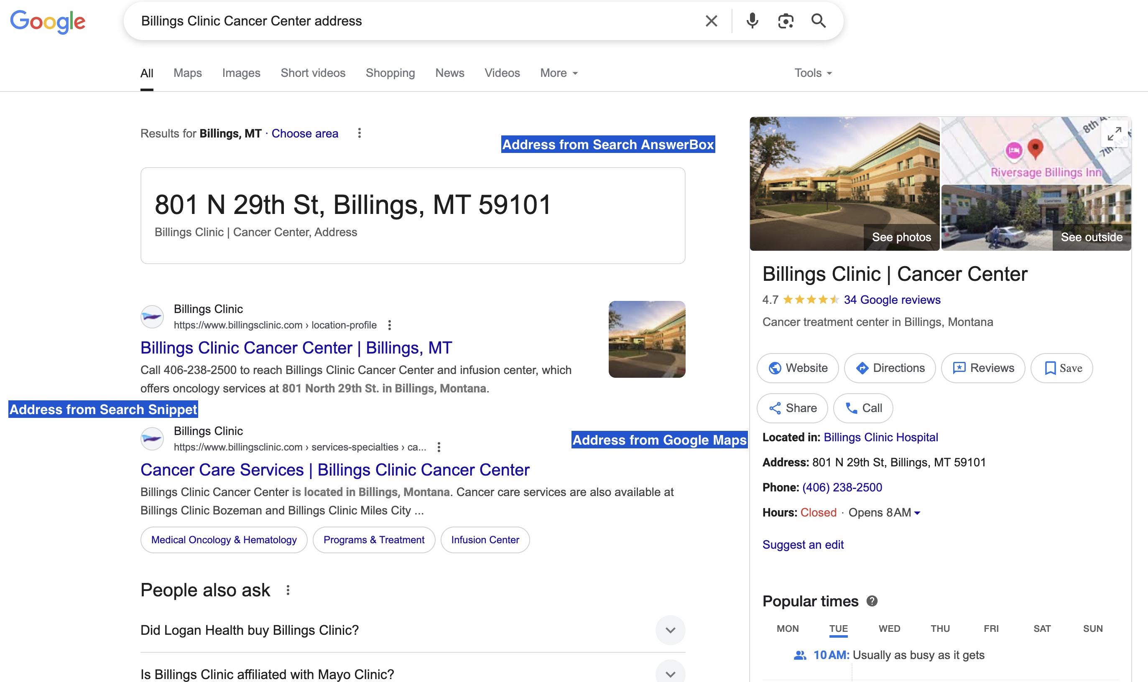
Further Improvements in URL Extraction: Serper API
Bonus: Additional extraction
Extracts addresses from Google Search, Answer box and Maps. The last two serve as fallback addresses.
The reason being, web-scraping tools like Beautiful Soup/ Playwright sometimes struggle with address extraction.
But Serper API does not struggle.

Slide 9
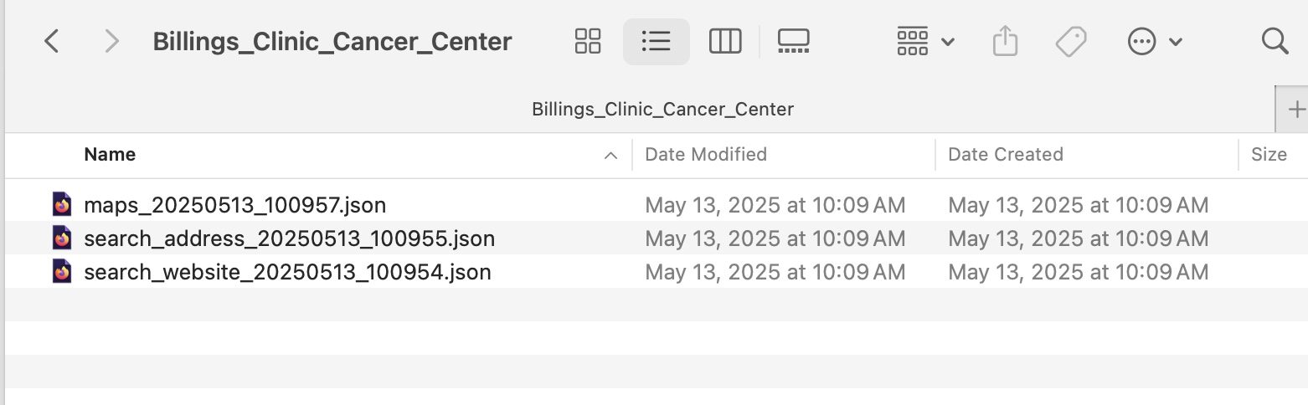
Further Improvements in URL Extraction: Serper API
Bonus: Additional extraction
3 Json files, for each of the 3 created locally.
These JSON files contain additional information which can be leveraged to improve accuracy of extracted addresses.
Screenshot of Sample JSON files created locally

Slide 10
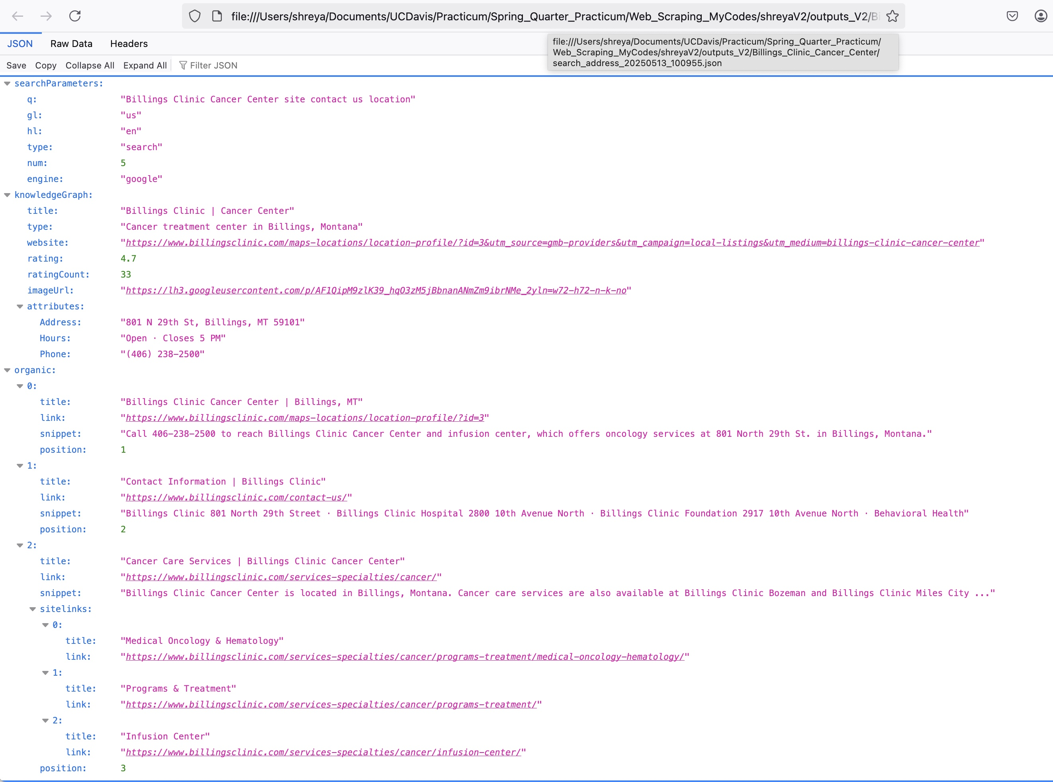
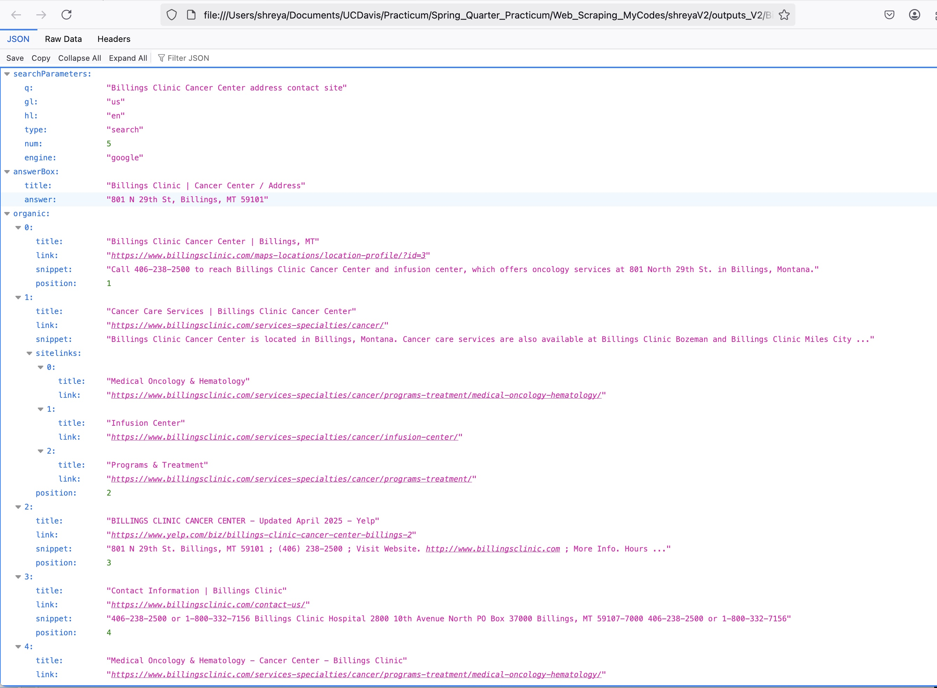
Further Improvements in URL Extraction: Serper API
Bonus: Deep-dive into JSON files
Saves top-N organic address search results. These additional URLs can be potentially sent to web-scraping step for address extraction if primary URL returns incorrect address.
The reason for this being, first organic search result may not be the official URL.
Additionally, sometimes, listings pages like Yelp contain addresses but official website may not.
Screenshot of Google Search JSON
Screenshot of Google answer box JSON

Slide 11
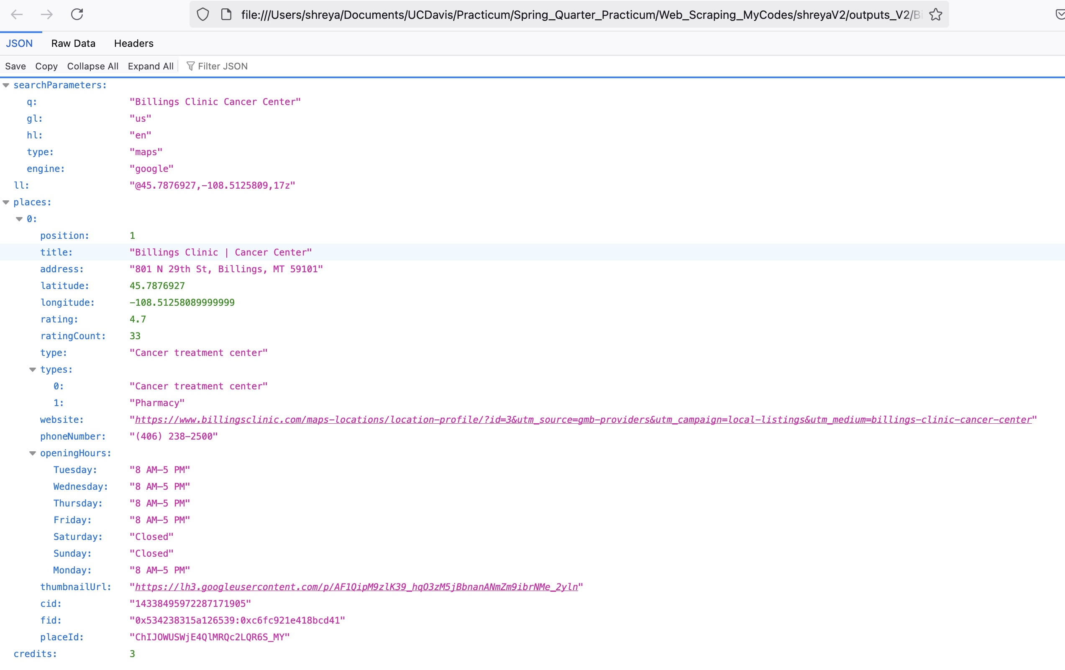
Further Improvements in URL Extraction: Serper API
Bonus: Deep-dive into JSON files
Screenshot of Google Maps JSON
Saves Latitude, Longitude of the agency address
Additionally, retrieves Google Maps Places ID, potentially serving as healthcare facility identifier in future.
Latitude, Longitude of agency
Google Places ID

Slide 12
To address this, we built an intelligent pipeline to automatically complete missing addresses

Slide 13
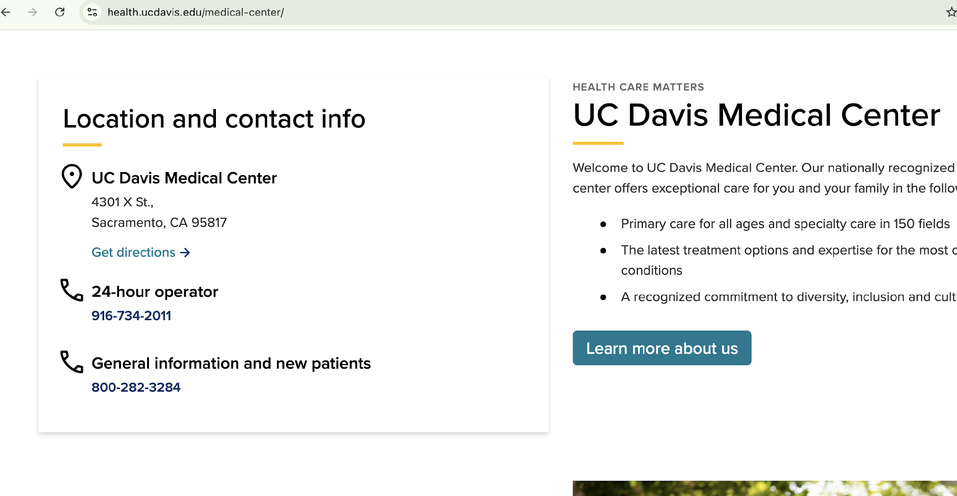

Then, we taught a bot to ‘read’ websites like a smart assistant
It’s just like a smart assistant that goes to a website, reads the page, finds the important information we need, and saves it for us.

Slide 14
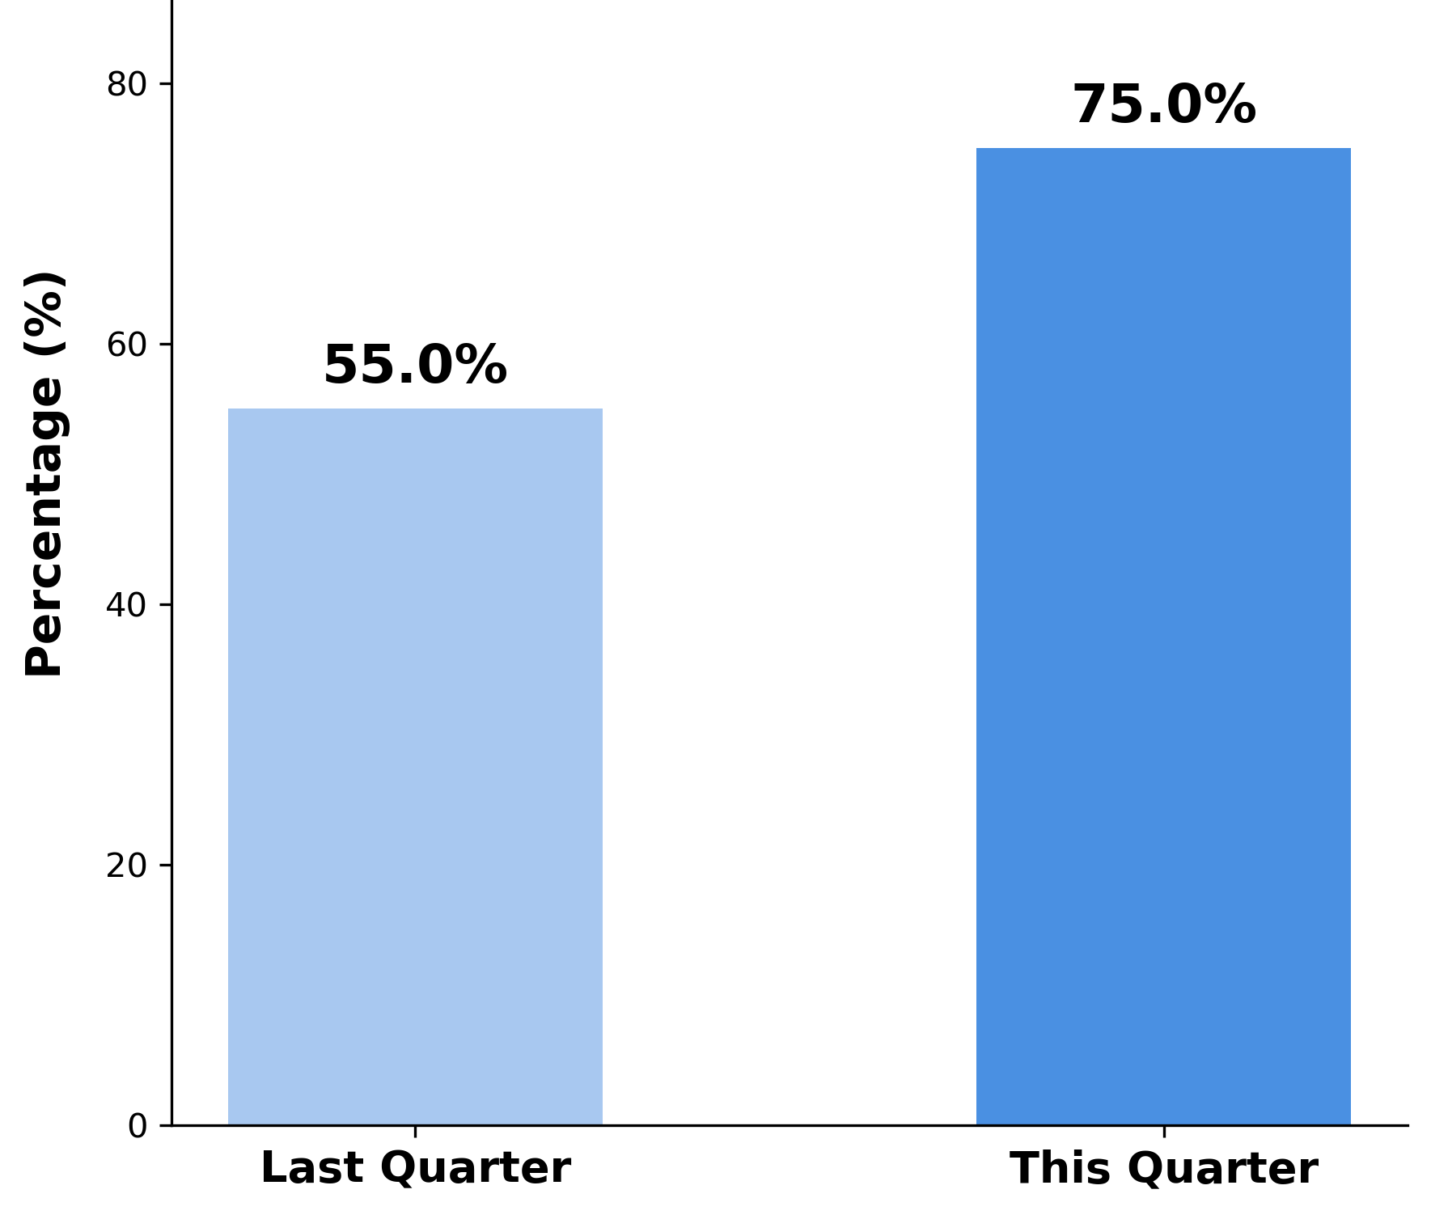
The bot succeeded in over half of cases—but challenges remained
Success Rate of Extraction
Normalization
Multi-Method Extraction
St.’ → ‘Street’
Special characters
Multi-line addresses → single line
Regex matching for free-text address detection.
HTML tag scanning (<p>, <span>, <div>, <a>) for embedded address formats.
PlayWright for dynamic website
Batch Processing & Automation
Enable bulk URL input instead of manually entering websites.
Connecting Pipelines
Automate the extraction process
Examples of extracted data:
Agency Name | Website | Extracted Address
St Vincent Gastroenterology | https://www.christushealth.org/locations/st-vincent | ['455 Street michael Drive santa fe nm 87505', '455 Street michaels drive santa fe nm 87505', '455 hospital Drive santa fe nm 87505']
Notes:
75%

Slide 15
Further Improvements in Web-Scraping
A simple, lightweight tool for scraping static HTML.
It’s fast and easy to use but doesn’t work on dynamic or JavaScript-heavy pages.
PlayWright
Beautiful Soup
A browser-based scraper for dynamic content.
It handles JavaScript, logins, pop-ups, and even supports LLM-based extraction.
✔ Static HTML
✔ Renders full webpages
✔ Lightweight and easy to implement
✔ Supports LLM-based extraction
✘ Dynamic, modern websites
✔ Simulates browser behavior (login, pop-ups, cookies)
All scraping for Playwright is done as the page is rendered on Chrome Browser

Slide 16
Filtering for Agencies with Complete Address Records in the Database
5

Slide 17


Identification of correct airport
Single leg flights
For each flight trip,
Categorized trips into: Treatment to Home, and Home to Treatment
 | Direction | Recorded
 | Treatment to Home | Departure Airport
 | Home to Treatment | Arrival Airport

Slide 18
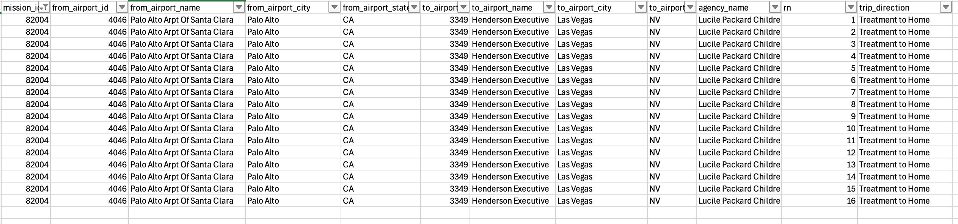

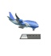
Identification of correct airport
Multiple leg flights
For each flight trip,
Categorized trips into: Treatment to Home, and Home to Treatment
Within each categorization, there are multiple legs, spread out on different rows in database table
 | Direction | Multiple Legs | Recorded
 | Treatment to Home | [First Flight/Treatment] -> [Leg 1] -> [Leg 2] -> [Leg 3] -> [Leg n] -> [Last flight/ Home] | First airport as Departure Airport
 | Home to Treatment | [First Flight/ Home] -> [Leg 1] -> [Leg 2] -> [Leg 3] -> [Leg n] -> [Last Flight/ Treatment] | Last airport as Arrival Airport

Slide 19
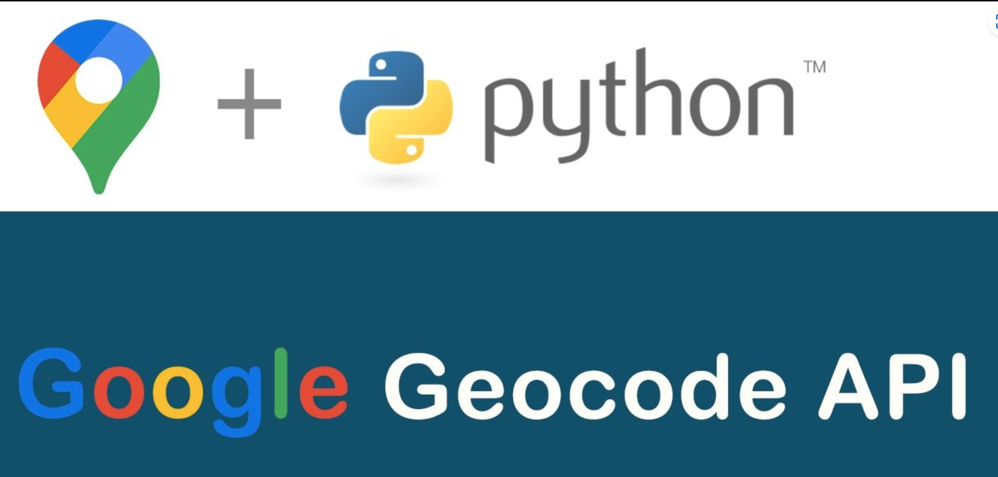
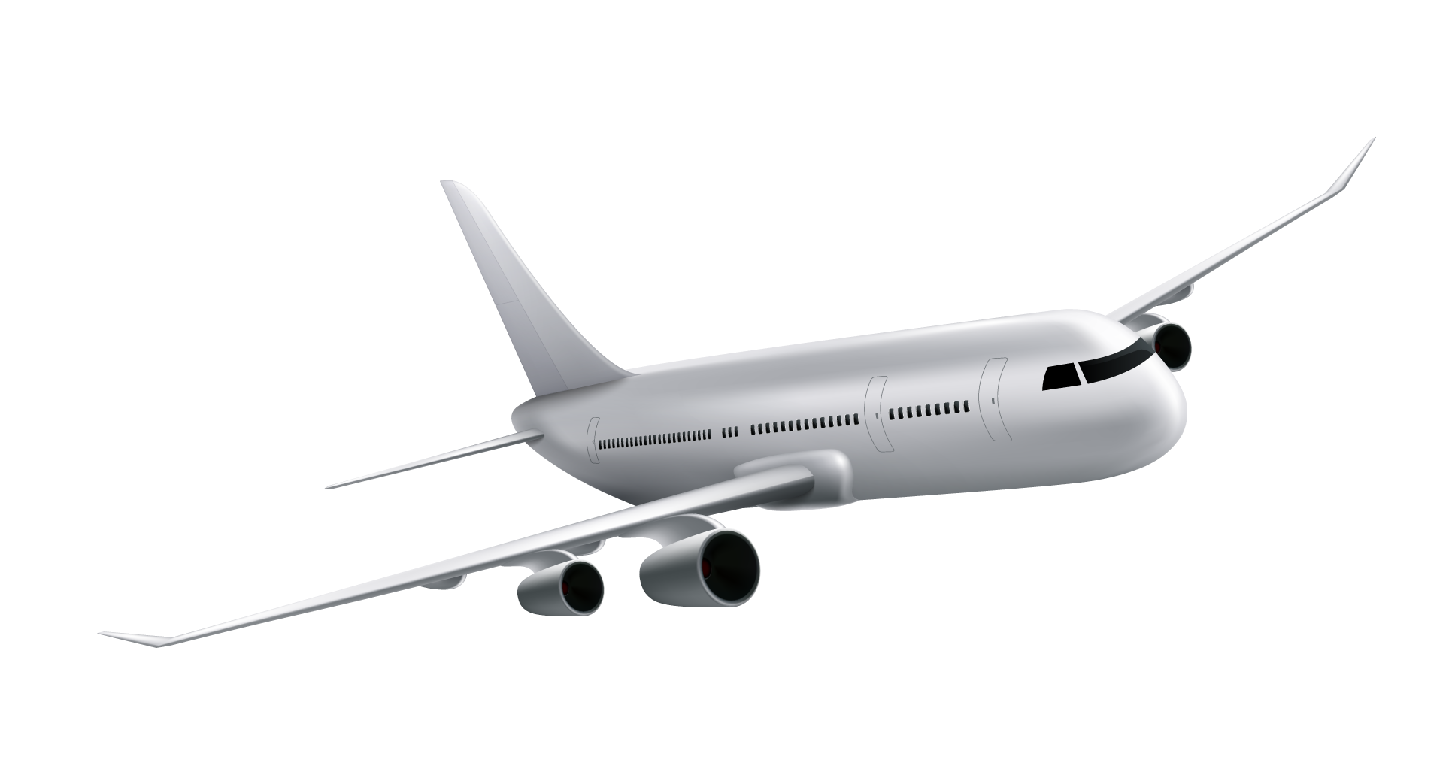
Distance—from address to airport—to identify the best match
Airport : JFK
Extracted Addresses:
1270 Belmont Ave., Schenectady, NY 12304
315 S. Manning Blvd., Albany, NY 12208
2215 Burdett Ave., Troy, NY 12201
 | Address | Latitude | Longitude | Airport
 | 1270 Belmont Ave.,Schenectady, NY 12304 | 42.82° N | -73.91° W | JFK (40.38° N, 73.46°W)
 | 315 S. Manning Blvd., Albany, NY 12208 | 42.66° N | -73.80° W
 | 2215 Burdett Ave., Troy, NY 12201 | 42.73° N | -73.67° W

Slide 20
Closest address to the destination airport is most reliable guess
Once we obtain the coordinates for each extracted address, we proceed to compute the geographical distance between these addresses and the target airport.
 | Address | Latitude | Longitude | Airport | Distance (miles)
 | 1270 Belmont Ave., Schenectady, NY 12304 | 42.82° N | -73.91° W | JFK (40.38° N, 73.46°W) | 143.6
 |  |  |  |  | 132.8
 | 315 S. Manning Blvd., Albany, NY 12208 | 42.66° N | -73.80° W
 |  |  |  |  | 141.2
 | 2215 Burdett Ave., Troy, NY 12201 | 42.73° N | -73.67° W
By comparing the distances from each extracted address to the airport, we identify the address that is geographically closest to the airport. This address is then selected as the best match for further processing or verification.

Slide 21
Validation of Current Proposed Web-scrapping Pipeline
Agency Selection
Choose 67 agencies with address on AFW file, had a flight request in last 8 years, had a requester attached, sorted in descending order of most number of flights requested
Web-scrapping Pipeline
Google Custom Search API/ Serper API to extract website URL
Web-scrapping Pipeline
Beautiful Soup/ Playwright for address extraction
Airport Proximity Pipeline
For agencies with multiple address returned by web-scraping pipeline, choose address geographically closest to airport
LLM for verifying address on AFW file against address extracted by web-scraping pipeline Leverage gpt-4o-mini model
Results from Google Answer Box, Google Search, Google Maps The last two serve as fallback addresses
Business Logic:
These agencies underwent most scrutiny when AFW team noted address. Hence, address on AFW can be trusted
Extraction Rate:
Retrieved URLs for 100% agencies
Extraction Rate:
Out of these agencies with URLs retrieved, retrieved address for 82% agencies from URL
Pipeline:
Leveraged flight trip data from tables on VPOIDS database.
Correctly deals with flights with single and multiple legs
Correctly categorizes trips into 2 trip directions
Business Logic:
Address on AFW file is gold standard.
Basis prompts given to LLM, it categorizes address matching into 5 categories: Exact substring match, slight misspelling, same words – different order, one word difference, no match
Business Logic:
Address The reason being, web-scraping tools like Beautiful Soup/ Playwright sometimes struggle with address extraction
But Serper API does not struggle
20
Notes:
Note: Count numbers for each of the categories above are from last year’s audit. This analysis was done on 250 agencies only. This year’s work will be basis 1000 agencies

Slide 22
Validation of Current Proposed Web-scrapping Pipeline | Numbers
Agency Selection
Choose 67 agencies with address on AFW file, had a flight request in last 8 years, had a requester attached, sorted in descending order of most number of flights requested
Web-scrapping Pipeline
Google Custom Search API/ Serper API to extract website URL
Web-scrapping Pipeline
Beautiful Soup/ Playwright for address extraction
Airport Proximity Pipeline
For agencies with multiple address returned by web-scraping pipeline, choose address geographically closest to airport
LLM for verifying address on AFW file against address extracted by web-scraping pipeline Leverage gpt-4o-mini model
Results from Google Answer Box, Google Search, Google Maps The last two serve as fallback addresses
67 agencies
URL extracted for
67 agencies (100%)
Address extracted for
55 agencies (82%)
All these 55 agencies (82%) now have one address against their name
Exact Substring Match:
36 agencies (53%),
One word Difference:
2 agencies (2.9%),
No Match:
17 agencies (25.3%)
Out of the agencies with No Match, 5 agencies were found correctly in Answer Box, Search, Maps
Percentage numbers quoted at each step above are out of total 67 agencies.
LLM (gpt-4o-mini) results were also manually eyeballed and confirmed
21
Notes:
Note: Count numbers for each of the categories above are from last year’s audit. This analysis was done on 250 agencies only. This year’s work will be basis 1000 agencies

Slide 23
Validation of Current Proposed Web-scrapping Pipeline
Agency Selection
Choose 67 agencies with address on AFW file, had a flight request in last 8 years, had a requester attached, sorted in descending order of most number of flights requested
Web-scrapping Pipeline
Google Custom Search API/ Serper API to extract website URL
Web-scrapping Pipeline
Beautiful Soup/ Playwright for address extraction
Airport Proximity Pipeline
For agencies with multiple address returned by web-scraping pipeline, choose address geographically closest to airport
LLM for verifying address on AFW file against address extracted by web-scraping pipeline Leverage gpt-4o-mini model
Results from Google Answer Box, Google Search, Google Maps These three serve as fallback addresses
67 agencies
URL extracted for
67 agencies (100%)
Address extracted for
55 agencies (82%)
All these 55 agencies (82%) now have one address against their name
Exact Substring Match:
36 agencies (53%),
One word Difference:
2 agencies (2.9%),
No Match:
12 agencies (25.3%)
Correct Match found in
Answer Box, Search, Maps:
5 agencies (7.4%)
Address not returned from Web-scraping pipeline
(URL Extraction + Web- Scraping):
12 agencies (18%)
Percentage numbers quoted at each step above are out of total 67 agencies.
LLM (gpt-4o-mini) results were also manually eyeballed and confirmed
22
Notes:
Note: Count numbers for each of the categories above are from last year’s audit. This analysis was done on 250 agencies only. This year’s work will be basis 1000 agencies

Slide 24
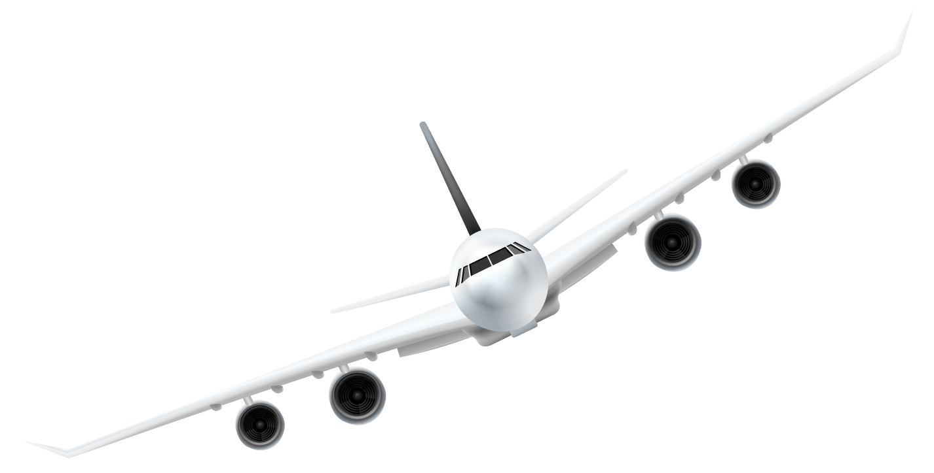
Combined, these tools form a smart and scalable address-completion pipeline
Custom Search
Proximity-based Filtering
Google Places API
Web-Scraping
Find Agency’s official website
Automates bulk searches
Improved success rate: 19% → 80% →100% (Serper API)
Select the most appropriate address
Converts addresses to geocoordinates
Matches with associated airport info
Filters for the closest and most valid address
First attempt using Google’s official database.
Automatically retrieves addresses
Some agencies cannot be matched, requiring further steps.
Extract Addresses
Added Playwright for browser-level rendering
Handles unstructured, dynamic content (e.g. JavaScript, pop-ups)
55% → 82% extraction success rate
2
1
3
4

Slide 25
How Our Pipeline Evolved
75%
44%
11%
Serper API + Webscraping
(Beautiful Soup + Playwright)
Custom Search + Webscraping
(Beautiful Soup)
Dynamic search + browser-level scraping enabled us to reach a 75% success rate, even on complex websites.
No Custom Search
Adding targeted search improved the match rate significantly on static pages.
Webscraping alone, without search engine support, resulted in a very low success rate.
24

Slide 26
Thanks!
Instructor: Josue & Carrie
Author: Sherya, Ruijie, Wenjun, Amit, Peilu
25

